Slide 1
Chapter 2 Configuration Space
Chapter 3 Rigid-Body Motions
Chapter 4 Forward Kinematics
Chapter 5 Velocity Kinematics and Statics
Chapter 6 Inverse Kinematics
Chapter 7 Kinematics of Closed Chains
Chapter 8 Dynamics of Open Chains
Chapter 9 Trajectory Generation
Chapter 10 Motion Planning
Chapter 11 Robot Control
11.1 Control System Overview
11.2 Error Dynamics
Chapter 12 Grasping and Manipulation
Chapter 13 Wheeled Mobile Robots

Slide 2
Important concepts, symbols, and equations
Example control objectives:
motion control
force control
hybrid motion-force control
impedance control

Slide 3
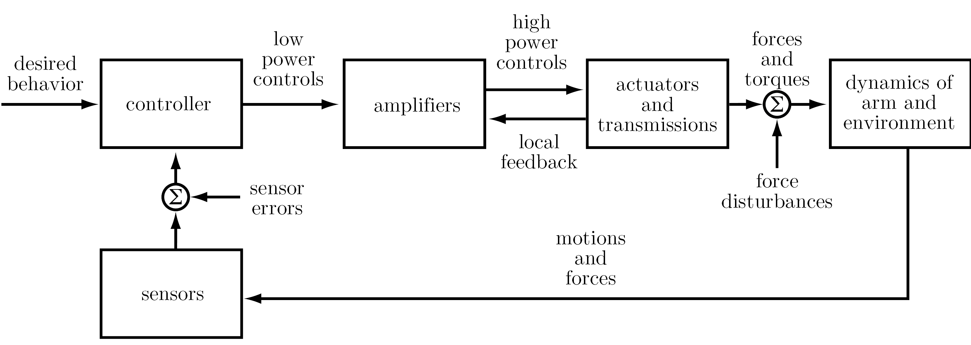
Important concepts, symbols, and equations (cont.)
Control system block diagram:

Slide 4
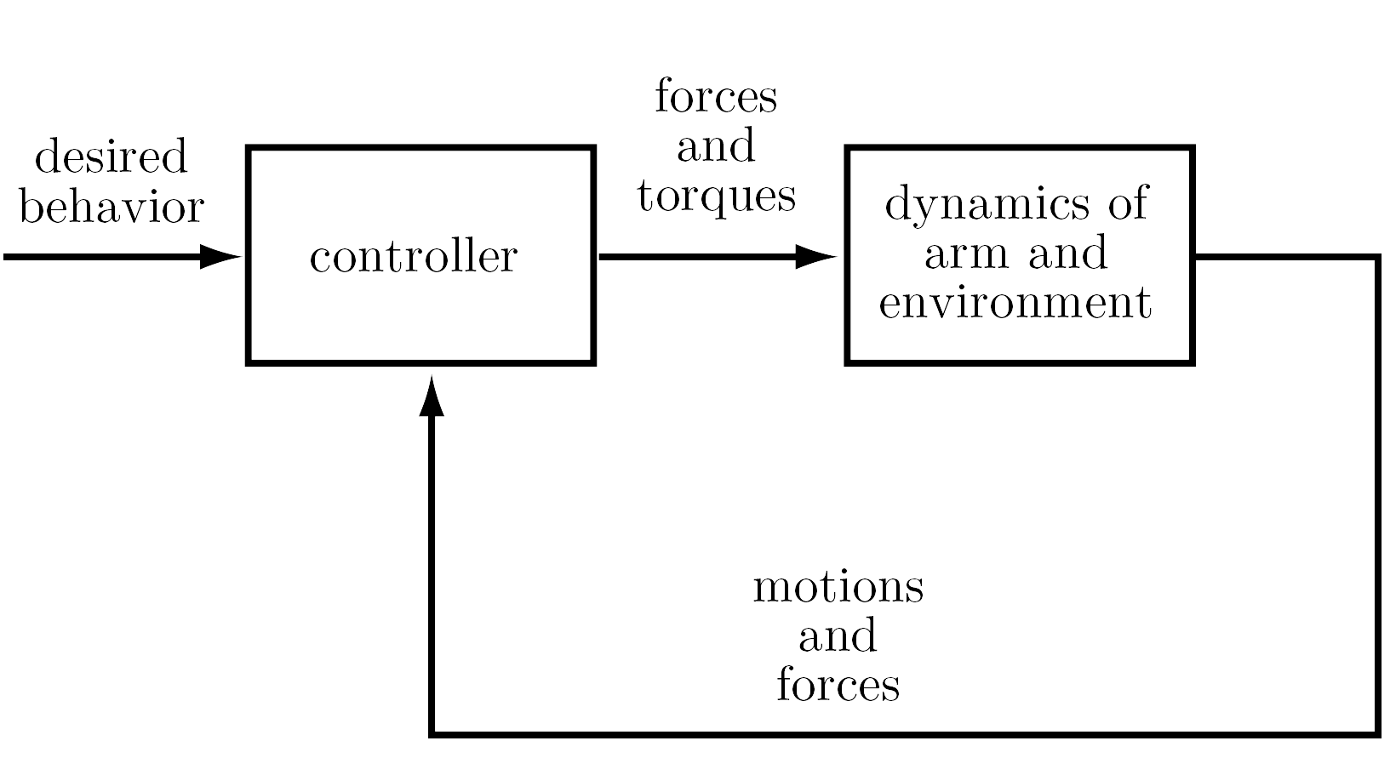
Important concepts, symbols, and equations (cont.)
Simplified block diagram:
Also assuming continuous-time (not discrete-time) control.

Slide 5
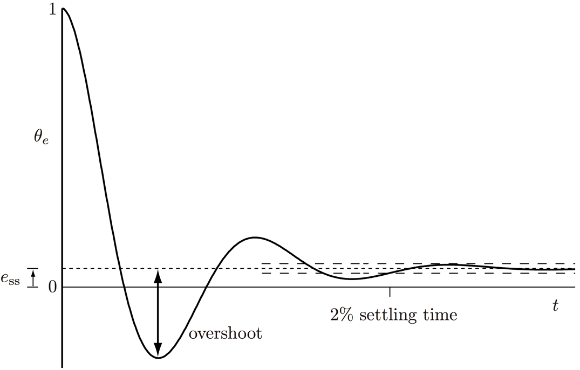
Important concepts, symbols, and equations (cont.)
For motion control,
reference: 𝜃_{d}(t)
actual: 𝜃(t)
error: 𝜃_{e}(t) = 𝜃_{d}(t) − 𝜃(t)
Unit step error response:
𝜃_{e}(t) starting from 𝜃_{e}(0) = 1
Steady-state error response: e_{ss}
Transient error response:
overshoot, settling time
b
overshoot = |a/b| × 100%
a

Slide 6
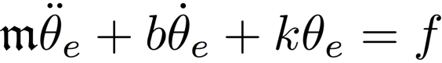
Important concepts, symbols, and equations (cont.)
System dynamics, feedback controllers, and error response are often modeled by linear ordinary differential equations.
The simplest linear ODE exhibiting overshoot is second order, e.g.,
or, if f = 0,
k and b depend on the control law

Slide 7
Important concepts, symbols, and equations (cont.)
A more general p^{th}-order linear ODE:
nonhomogenous
homogeneous

Slide 8
Important concepts, symbols, and equations (cont.)
Defining a state vector x = (x₁, x₂, ..., x_{p}), you can write the p^{th}-order ODE as p first-order ODEs (a vector ODE).
→

Slide 9
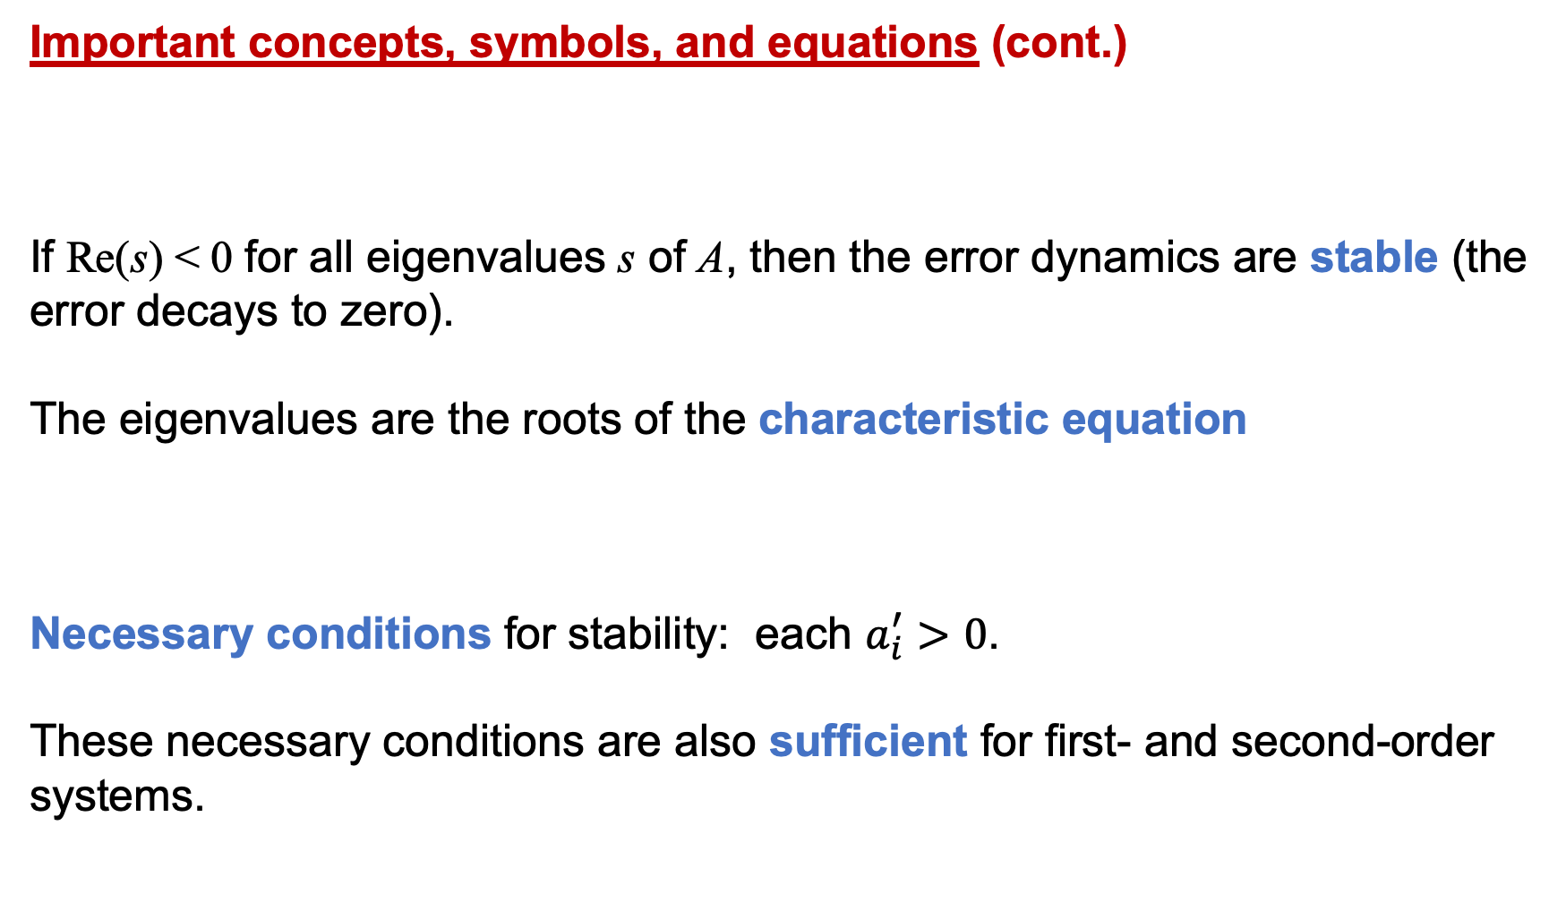
Important concepts, symbols, and equations (cont.)
If Re(s) < 0 for all eigenvalues s of A, then the error dynamics are stable (the error decays to zero).
The eigenvalues are the roots of the characteristic equation
Necessary conditions for stability: each $a_{i}^{′}>0$.
These necessary conditions are also sufficient for first- and second-order systems.
→

Slide 10
Types of control for the following tasks:
Shaking hands with a human
Erasing a whiteboard
Spray painting
Back massage
Pushing an object across the floor with a mobile robot
Opening a refrigerator door
Inserting a peg in a hole
Polishing with a polishing wheel
Folding laundry

Slide 11
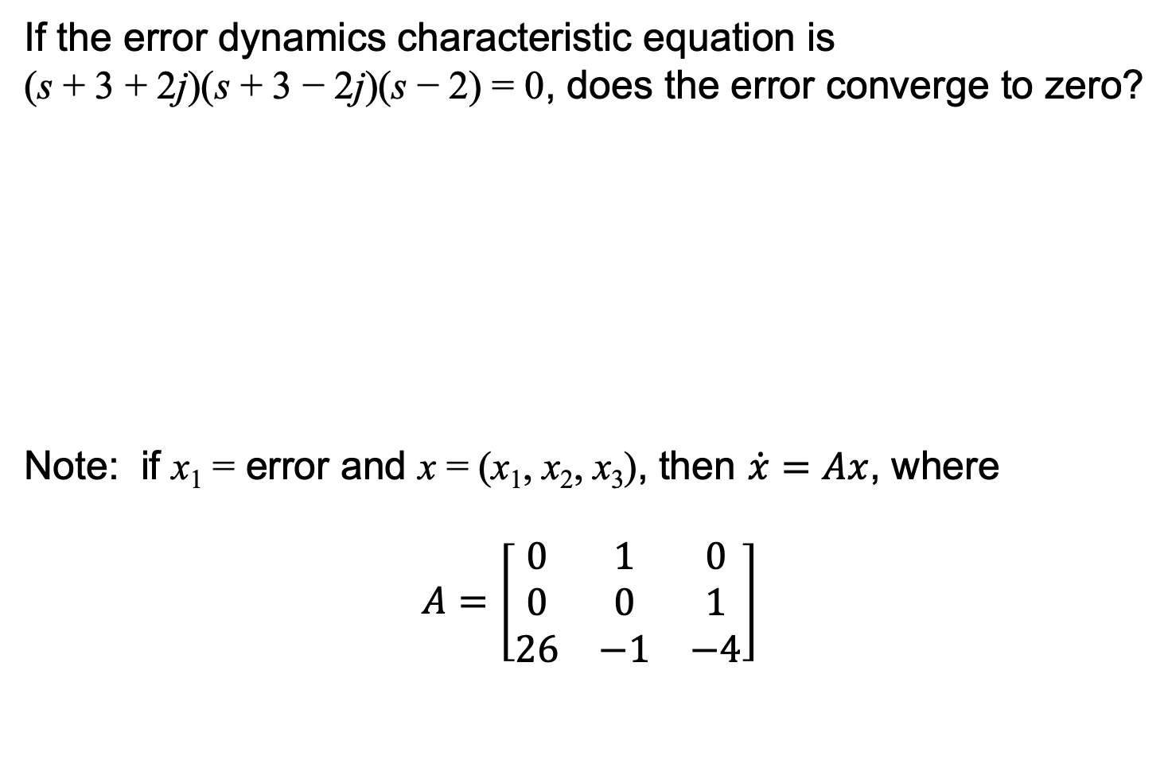
If the error dynamics characteristic equation is
(s + 3 + 2j)(s + 3 − 2j)(s − 2) = 0, does the error converge to zero?
Note: if x₁ = error and x = (x₁, x₂, x₃), then $\dot{x}=Ax$, where
$$A=\left[\begin{matrix}0 & 1 & 0 \\ 0 & 0 & 1 \\ 26 & −1 & −4\end{matrix}\right]$$

Slide 12
You can choose a control law to be a virtual spring, a virtual damper, a
virtual spring plus damper, or nothing. Which of these could stabilize an
actuated pendulum with viscous friction to the upright configuration? To a
horizontal configuration? To the downward configuration? Describe the
transient and steady-state error response for each.
⤿
g

